Slide 1
HIRADMAT In the WANF Tunnel I. Efthymiopoulos, EN/MEF
Layout
Preliminary study → discuss main issues, not technical details
Dismantling of WANF → a possible (minimal) scenario
Schedule & budget envelop estimate
If not in WANF where else ?
HIRADMAT-Exp.Area Working Group
EN/MEF : I. Efthymiopoulos, A. Pardons, M.Lazzaroni, N. Gilbert
AB/SU : G. Roy, L. Bruno
SC/RP : N. Conan, H. Vincke, D. Forkel-Wirth, L. Ulrici
EN/HE : A. Calderone, Y. Bernard, K. Kershow
EN/CV : J. Inigo-Golfin
EDMS No : 984446
HIRADMAT Meeting
CERN, January 26, 2009

Slide 2
The TCC6/WANF complex
Layout – today’s status
T1 target
TI2 line to LHC
TT61 tunnel – old extraction to West Area
WANF tunnel : T9 target & Secondary beam
T9
collimator
Horn
He tank
Fe-shielding
Horn
He-tank
Decay
Tube
Old proton beam (dismounted)
Intensity
Monitor
BA7
Access shaft (material & personnel)

Slide 3
The TCC6/WANF complex
WANF Tunnel during installation - 1992

Slide 4
The TCC6/WANF complex
WANF Tunnel during installation - 1992

Slide 5
The TCC6/WANF complex
WANF tunnel – September’08
He-tank
T9 target

Slide 6
High-Power Radiation Facility (HIRADMAT)
Design parameters for the experimental area
Specification document
Parameter | Value
Experiments per year | 10
Maximum intensity per experiment | 1×10¹⁵ protons <30 full intensity pulses
Waiting time after experiment for de-installation | ≥ 2 weeks
Access during experiment (except urgent interventions) | no
Control of experiment and data taking | remote
Maximum intensity per year | 1×10¹⁶ protons
Parameter | Value
Installed experiments | 1
Material exposed to beam | C, CFC, Cu, W, hBN, Al, Be, …, advanced composite materials
Volume of exposed material | ≤ 16,800 cm³
Equipment size Length (flange-to-flange) Width Height below beam line Height above beam line | ≤ 7.0 m ≤ 1.0 m 1.1 m ≤ 0.8 m
Weight | ≤ 4,000 kg
Handling zone (L × W × H) | 15 × 2.0 × 2.2 m³
Equipment support | comes with experiment – quick installation interface required
Cool-down space | see equipment size
Crane support | mobile cranes sufficient
Handling | no full remote handling, prepare fast handling (e.g. rails)
Additional requirements for the exp. area will depend on the type of equipment and test planned
Safety and RP constraints should come in addition
Discussions within the WG – major issues presented today, details to come with the technical design of the facility

Slide 7
HIRADMAT in the WANF tunnel
Layout proposal
Cleanup the whole tunnel
Dismantle/condition WANF equipment
Horns/He-tanks could be stored locally until disposal path (and budget) agreed
Move the rest to waste
Maintain escape passage from tunnel end
Test area upstream the T9 target
Convert T9 to a beam dump
Remove target head and replace with special blocks like in CNGS hadron stop: Graphite core, Al plates with cooling
Add lateral shielding (concrete)
Reuse blocks from T1 (TAX area) to add downstream shielding

Slide 8
HIRADMAT in the WANF tunnel
Pros/cons of the proposal
The WANF tunnel is perfectly adequate to the foreseen usage
Test areas and nearby locations for irradiations with separate access
Overhead crane with remote manipulation
Closed ventilation loop available
Nearby areas for preparation/cool-down of test equipment
The (remaining) proton beam and WANF secondary beam has to be dismantled
However WANF has been deteriorating for almost a decade, cleaning-up and re-using the tunnel for an irradiation facility is in the interest of the organization and RP guidelines
Dismantling the WANF secondary beam is feasible
Expected collective radiation dose not excessive compared to other works (more in H.Vincke’s talk)
The equipment (horns, He-tanks, etc.) was designed to be easily dismountable
The T9 which is the “hotest” part will be re-used
Water infiltrations in the tunnel must be treated
T1 has to be dismantled (at least the downstream part) to allow easy access for installation and service of the new beam line equipment

Slide 9
HIRADMAT Facility
Operation/maintenance
HIRADMAT will be a FACILITY to run for the LHC lifetime (and beyond?)
The Exp. Area must be carefully designed from the beginning to satisfy the needs for the future users
This affect the services, installation, etc. that would be hard to add/modify afterwards due to radiation levels
M&O costs and safety conditions should be included in the project
Personnel access, external users, waste, etc.
Surface labs/offices …

Slide 10
HIRADMAT in the WANF tunnel
Schedule
Assuming WANF is the accepted location of the facility :
Project milestones:
March’09 : prepare detailed study – review
March’09-Sep’09 :
Dismantling of WANF ; system/services maintenance
Dump design, procurement, construction
Sep’09 – shutdown : limited access due to LHC operation
>Shutdown’09 : installation
October ’10 : facility ready for beam
Tendering & Finance committee will be an important factors in the planning
Resources in various groups must be discussed/agreed

Slide 11
HIRADMAT in the WANF tunnel
Budget envelop
Note:
These are preliminary estimates without detailed analysis of the works
No (known) contingency added
The items in blue may be staged
The status of services (ventilation, electricity, cooling, etc.) will be defined following inspections in situ
The clean-up, conditioning (and dismantling) of WANF equipment will be done by a specialized company
Few contacts already; specs and tendering in preparation
The dismantling procedure will be defined and agreed by safety officials and RP
Need the “green light” to advance the studies and come with a better estimate
The dismantling cost of HIRADMAT includes dismantling of all WANF items
Would very much depend on the operation of the facility, materials used, etc.

Slide 12
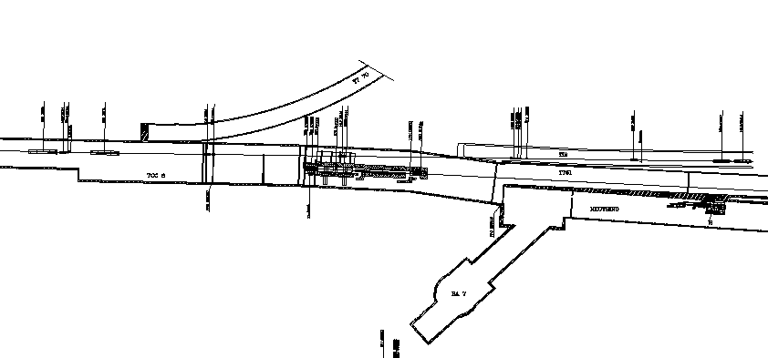
HIRADMAT: if not in WANF where else?
TCC1, around T1 target area
Option-C
Clean tunnel to work
Close to TI2 line; possible to move further downstream, however the tunnel has very steep slope (8%)
Relatively narrow tunnel ; difficult to put lateral shielding and manipulate large objects
Difficult access conditions in the area
Ventilation: SPS exhaust goes through TT61
Option-B
Downstream the T1 target
B
C
Option-B
Free area of >10m downstream T1
Two measurement positions possible
Locations for electronics in downstream areas + TT61
No crane available, remote handling to be done with rail system
Dismantling of T1 elements (head)
Ventilation: TCC6 serves as the exhaust of SPS via TT61
Separate volume for HIRADMAT?
Radiation in downstream areas, and TI2/LHC
Option-C
Upstream part of TT61 tunnel
A
Option-A
Old WANF tunnel (half)

Slide 13
HIRADMAT in the WANF tunnel
Summary
The HIRADMAT is an important facility for key components of LHC and its upgrades
The presented implementation in the WANF tunnel satisfies all the requirements, and is in agreement with RP and safety guidelines
The required (partial)dismantling of WANF is certainly an issue, however not significantly different from other works in the tunnels
The other options (TCC6, TT61) would compromise the operation of the facility, most likely without major gain in cost
To advance the studies and come with better budget estimate and planning, resources from several groups must be allocated to the project. Therefore the presentation today!

Slide 14
Backup slides

